Slide 1
Knowledge Representation

Slide 2
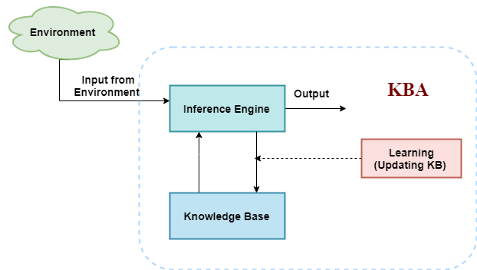
Architecture of Knowledgebase Agent

Slide 3
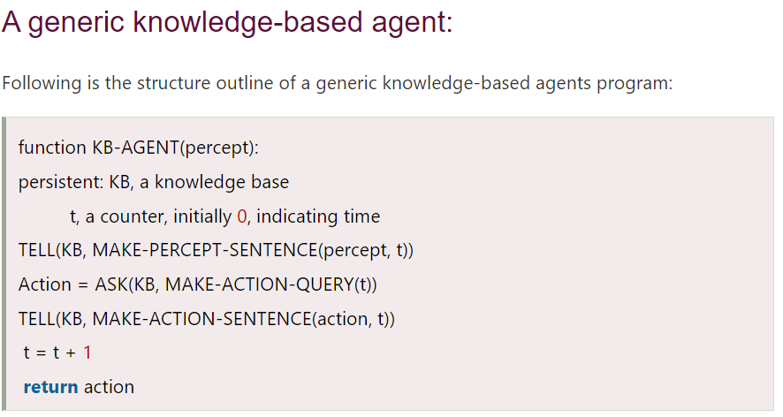

Slide 4
Issues
To solve complex problems in AI, to create new solutions.
  Large amount of Knowledge
  Some mechanism for manipulating that Knowledge

Slide 5
Types of Knowledge
Declarative Knowledge
Procedural Knowledge
Inheritable Knowledge
Inferential Knowledge
Relational Knowledge
Heuristic Knowledge
Common Sense Knowledge
Explicit Knowledge
Implicit Knowledge
Uncertain Knowledge

Slide 6
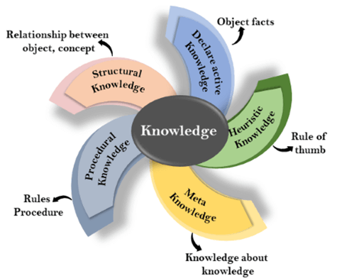

Slide 7
Types of Knowledge
Declarative :
Simple facts about phenomenon or entity
Assertions
Procedural : Functioning of entity.

Slide 8
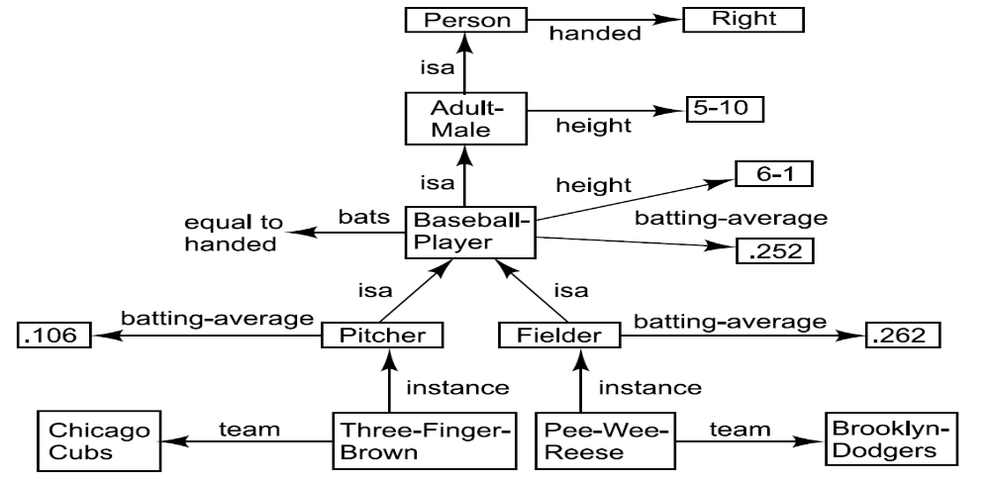
Inheritable

Slide 9
Types of Knowledge
Inferential : Which uses inference mechanism to use the knowledge . The inference procedures implements the standard logic rules of inference
Relational : Facts are represented as a set of relations in a tabular form . Used in database systems.

Slide 10
Types of Knowledge
Heuristic : Domain Specific.
        Good guessing
        Vary from person to person
Common Sense : Gained by experience , Not domain specific . Most difficult to encode and represent while devloping AI systems.

Slide 11
Types of Knowledge
Explicit : acquired, can be expressed in formal language. Communicable to others verbally or in stored form , can be transferred.
Tacit : one that is understood but not expressed in conventional form .
acquired by experience and difficult to express in formal language. (Two dimensions: Technical and cognitive)

Slide 12
Representation and Mapping
Knowledge is to be represented in usable form
Facts: things we want to represent.
Representations of facts: things we can manipulate.

Slide 13
Mapping of Facts and Representation
reasoning programs
Facts
Internal
Representations
English understanding
English generation
English
Representations

Slide 14
Representation of Facts
Initial
facts
desired real reasoning
Final
facts
forward representation mapping
backward representation mapping
Internal
representations
of initial facts
Internal
representations
of final facts
operation of program

Slide 15
Representation and Mapping
Spot is a dog
Every dog has a tail
Spot has a tail

Slide 16
Representation and Mapping
Spot is a dog
dog(Spot)
Every dog has a tail
∀x: dog(x) → hastail(x)
hastail(Spot)
Spot has a tail

Slide 17
Representation and Mapping
Fact-representation mapping is not one-to-one.
Good representation can make a reasoning program trivial.

Slide 18
Representation and Mapping
Properties desired by a system for representation of knowledge
Good representation:
Representational adequacy: The ability to represent all of the kinds of knowledge that are needed in that domain
Inferential adequacy: ability to manipulate the representational structures in such a way as to derive new structures corresponding to new knowledge inferred from old.
Inferential efficiency: the ability to into the knowledge structure additional information
Acquisitional efficiency: The ability to acquire new information easily.

Slide 19
Approaches to KR
Simple relational knowledge:
Provides very weak inferential capabilities.
May serve as the input to powerful inference engines.

Slide 20
Approaches to KR
Inheritable knowledge:
Objects are organized into classes and classes are organized in a generalization hierarchy.
Inheritance is a powerful form of inference, but not adequate.

Slide 21
Approaches to KR
Inferential knowledge:
Facts represented in a logical form, which facilitates reasoning.
An inference engine is required.

Slide 22
Approaches to KR
Procedural knowledge:
Representation of “how to make it” rather than “what it is”.
May have inferential efficiency, but no inferential adequacy and acquisitional efficiency.

Slide 23
Approaches to KR
Choosing the Granularity:
High-level facts may not be adequate for inference.
Low-level primitives may require a lot of storage.

Slide 24
Logic
Knowledge forms the base of all Intelligence possessed by Human.
Human mind applies some reasoning process to infer and apply knowledge for problem solving.
All men are mortal ;
  Socrates is a man
    Socrates is mortal
The process of drawing conclusion is known as reasoning.
Reasoning is construction, organization and manipulation of statements to arrive at new conclusion

Slide 25
Logic
How Reasoning is performed by mind? Which operations?
Logic is the expression given to the reasoning process performed by mind in the form of symbolic language .
AND , OR and NOT forms the heart of logical calculus.

Slide 26
First order Predicate Calculus
It presents a tool for describing propositions and truth values that make up the elements of mathematical reasoning.
Knowledge representation using formal language that is then manipulated by algorithms.
Logic is a formal language used to represent facts.

Slide 27
Elementary KR methodologies
Using Binary Numbers
As a set of pixels
In graphical form
In propositional logic
In predicate logic
Representation through Semantic Net
Representation using conceptual dependency structures.

Slide 28
Propositional Logic
Proposition is classified as declarative sentence whose value is either ‘true’ or ‘false’.
Two types :
  Atomic prepositions
    New Delhi is capital of India
    This statement is False
  Complex or molecular prepositions
      MSDhoni is a Cricketer and Sania Mirza is a tennis player

Slide 29
Syntax of Prepositional Calculus
Atomic Symbol: most elementary logic or preposition.
Logical connectives: ^ , ¬, V, →, , ( ) [ ]
(P ˅ Q)-> R ≠ P ˅ (Q -> R)

Slide 30
Semantics of Prepositional Calculus
Well formed formula(WFF) : legal Sentences
Consist of atomic symbols joined with connectives.
In pracctice there are two methods to define an object:
  In terms of the properties possessed by that mathematical object.
  Using recursion , in which initially some objects are declared and others are recursively defined using basic definition.

Slide 31
Well-Formed Formula (WFF)
Is defined recursively as :
  (i) If P is a propositional variable than it is WFF.
  (ii) if P is WFF than ¬ is a WFF.
  (iii) If P and Q are WFF then (P V Q ) , (P ∨ Q) , (P->Q ),
  (P <-> Q) are WFF
  (iv) A string of symbol is WFF iff , it is obtained by a finite number of applications of (i) – (iii)

Slide 32
To Note
A WFF is not a proposition, but if we substitute a proposition in place of a propositional variable , we get a proposition
The parenthesis can be dropped where there is no ambiguity.
The WFF can be represented as truth table
A WFF for all true entries is called tautology.
If two WFF A and B and if A <->B then A Ξ B
(difference ) : Formula, relation

Slide 33
Properties of statements (These are used to derive new statements in the process of inferencing)
(i) Valid : A sentence is valid if its true for all values of input and every interpretation.
(ii) Satisfiable : A statement having one interpretation for which it is true
It may not be necessarily valid
(iii)Unsatisfiable : If there is no preposition for which it is true
(P and not(P))
(iv) Equivalence : two statements are equivalent if for every interpretation they have the same truth value.
(V) Logical consequence: Statement s2 is said to be logical consequence of s1 if it is satisfied by all interpretations which satisfy s1
E.g P and P ^ Q , P is logical consequence of latter

Slide 34
Limitations
Each atomic symbol is denoted by different proposition:
E.g Ram is a student
Shyam is a student
Atoms have no internal structure
Every phenomenon is represented by separate preposition: If in the same prepositions variables are different they are different .

Slide 35
Inferencing in PL
Certain no. of propositions are assumed to be true and based on that some other propositions are derived.
Rules :
  Addition : Given P , infer ( P V Q) : P -> (P V Q)
  Conjunction : for two P and Q , infer P ^ Q : P ^Q -> (P ^Q)
  Simplification : Given P ^ Q , infer P : (P ^ Q) -> P
  Modus ponens : Given P and P->Q , infer Q : (P ^(P-> Q))-> Q
  Modus Tollens : ¬ Q and (P -> Q),infer ¬P : (¬Q ^ (P->Q))-> ¬P
  Chain Rule : ((P->Q) ^ (Q-> R)) -> (P->R)
  Disjunctive syllogism: Given ¬ P and (P V Q), infer Q
  Constructive dilemma: (((P->Q) ^ (R->S)) ^ (P V R))-> ( Q V S)
  Destructive dilemma: ((P->Q) ^ (R->S)) ^ (¬Q v ¬ S)-> (P V R)

Slide 36
Examples
Translate the following sentence into translational form.
  If it is not raining and I have time then I will go to movie.
  If it is raining and I will not go to movie
  It is not raining
  I will not go to movie
P,Q,R are the prepositions, used above, Write the sentences corresponding to the propositional form
  (¬ P ^ Q) <-> R
  (Q-> R) ^ (R -> Q)
  ¬ (Q v R)
  R-> ¬P ^ Q

Slide 37
Examples
Derive S from the following premises using a valid arguments
(i) P ⇒ Q (ii) Q ⇒ ¬ R (iii) P v S (iv) R
Sol^{n :}
(i) P ⇒ Q Premise (i)
(ii) Q ⇒ ¬ R Premise (ii)
(iii) P ⇒ ¬ R lines 1 and 2 and chain rule
(iv) R Premise (iv)
(v) ¬(¬ R) Using law of double negation
(vi) ¬ P using lines (iii) and (v) and rule of
        Modus tollens
        (vii) P v S Premise (iii)
        (viii) S using lines (vi) and (vii) and rule of disjunctive syllogism

Slide 38
To do
Test the validity of the following argument
If milk is black, then cow is white. If cow is white then ,it has four legs. If every cow has four legs, then every buffalo is white and brisk. The milk is black. Therefore , the buffalo is white.

Slide 39
Resolution
One application of AI is theorem proving.
Method to prove theorem is proof procedure
Proof procedures use ‘sound rules of inference that produce new expressions from the old expressions.
Resolution is one procedure for theorem proving
Principle of Resolution:
  Given two clauses C1 and C2 with no variables in common, If there is a literal L1 in C1 which is complement of Literal L2 in C2, both L1 and L2 are deleted and a disjuncted C is formed from the remaining clauses . The new clause is called resolvent of C1 and C2
Therefore , Resolution is process of these resolvents from a set of clauses

Slide 40
Resolution
Resolution based theorem proving is based on the technique of refutation.
  It assumes statement to be proved is not true .
  Then it proves , whatever we assumed is not true
    Hence the original statement is true.
Resolution with factoring is complete , that it will always generate the empty clause from a set of unsatisfiable clauses

Slide 41
Resolution (cont..)
Set { C1, C2,C3…Cn)
Goal: prove/Deduce D (D is logical consequence of C1 & c2 & C3 &…..& Cn
  Negate D and generate a clause ¬D,
  add this to set of clauses.
  Using resolution principle , we show that set is unsatisfiable by deducing a contradiction.
  In big system, all pairs of resolvable clauses are identified and resolved.

Slide 42
Summary (Resolution procedure)
Assume that the negation of the theorem , which is to be proved is true.
Show that the clauses and assumed negation of the theorem together can not be true.
Conclude that assumed negation of the theorem cannot be true , because it leads to contradiction.
Conclude that theorem must be true as the assumed negation of the theorem is not true.

Slide 43
Resolution (Cont.)
Note: Resolution is applicable only on the facts represented in clausal form.
Q: How to represent a propositional fact to the clausal form.
Eliminate the implication
Move the negation down to atomic formula
Eliminate the conjunction
Rename the variables if necessary.
Eliminate the universal quantifiers

Slide 44
Resolution algorithm in propositional logic
1. Convert all the statements of input to clausal form.
2. Assume negation of the literal is true (say ¬P) . Convert this to clause form and add it to the set of clauses of step 1.
Repeat till either a contradiction is found or no progress can be made.
  Select two clauses and call them parent.
  Resolve them together , if possible. The resulting clause is called ‘resolvent’.
  If the resolvent is empty clause then
    contradiction found
  Else
    Add it to the set of clauses available to the procedure.

Slide 45
Example (Resolution)
Demo of operation of resolution using flg. Propositions
A: P v Q v R
B: ¬ P V R
C: ¬ Q
D; ¬ R
Deduction tree

Slide 46
To do…
A: If a triangle is equilateral then it is isosceles .
B: If a triangle is isosceles then two sides AB = AC.
C: If AB=AC then angle B = angle C
D: ABC is an equilateral triangle.
Goal : Prove angle B = angle C.

